Slide 1
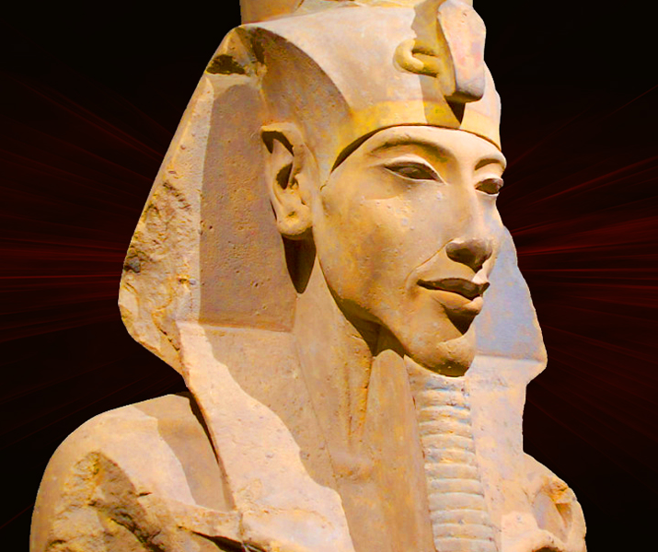
The 18th Dynasty
GOAL/S: Describe the 18th Dynasty
Explain Amenhotep IV’s transition to power
Week 9, Lesson 3

Slide 2

The Eighteenth Dynasty of Egypt (notated Dynasty XVIII, alternatively 18th Dynasty or Dynasty 18) is classified as the first dynasty of the New Kingdom of Egypt, the era in which ancient Egypt achieved the peak of its power. The Eighteenth Dynasty spanned the period from 1550/1549 to 1292 BCE.

Slide 3
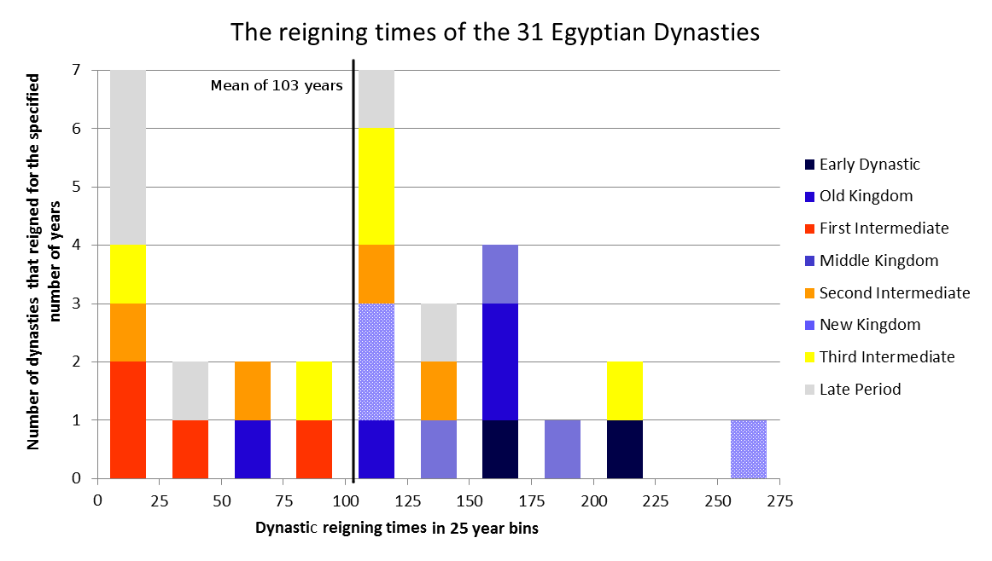
Dynasty
KEY TERM
DEFINITION:
A series of rulers sharing a common origin.
Traditionally divided into 33 pharaonic dynasties; these dynasties are commonly grouped by modern scholars into “Kingdoms” and “Intermediate Periods”
SYNONYMS: bloodline, ancestry, lineage

Slide 4

Ahmose I was the first pharaoh of this new dynasty, known as the 18th Dynasty, and its rulers would be some of the most prosperous and powerful in all of Egyptian history. Each one continued to grow Egypt's influence through successful military conquests which, in turn, funded some of Egypt's most famous monuments. Also, during this time, the city of Thebes became the most important location in Egypt, as pharaohs chose to build new palaces there and invest in the massive temple complex of Amun, called Karnak. Under the rule of Ahmose's successor, Amenhotep I (who ruled from around 1514 to 1493 BCE), the pharaohs began building their burial complexes on the western bank of the Nile River at Thebes, rather than in grand pyramids at Giza, as they did in the Old Kingdom. The naturally occurring valley in this new location was ideal for the construction of royal tombs. This area became known as the Valley of the Kings.

Slide 5
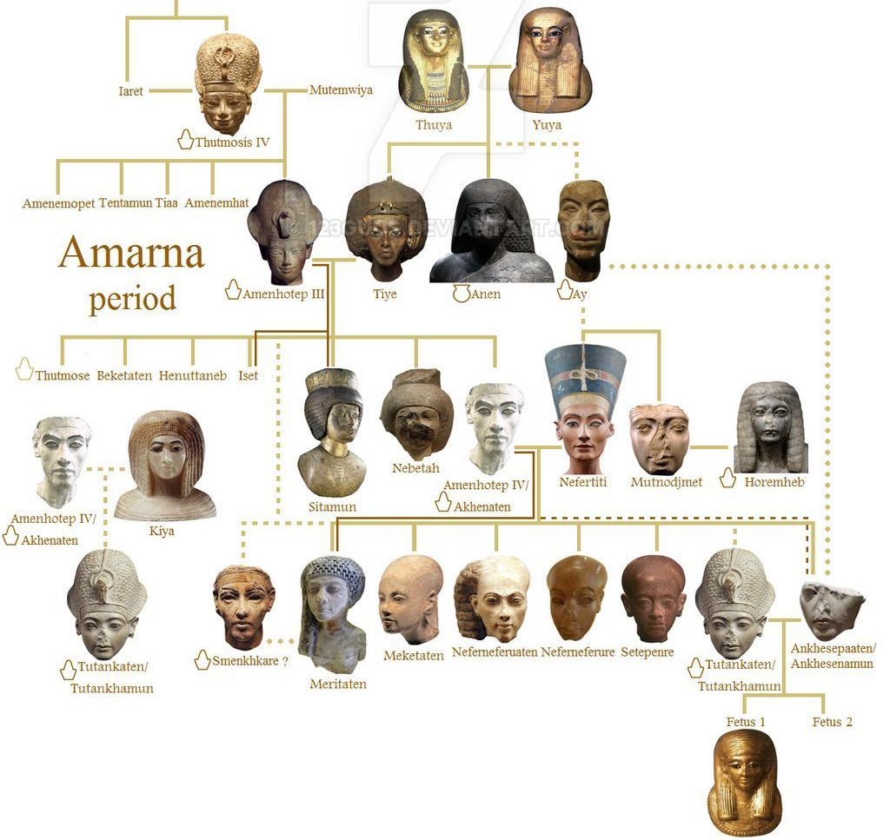
Cut out the
18th Dynasty family tree
Stick it in your book

Slide 6
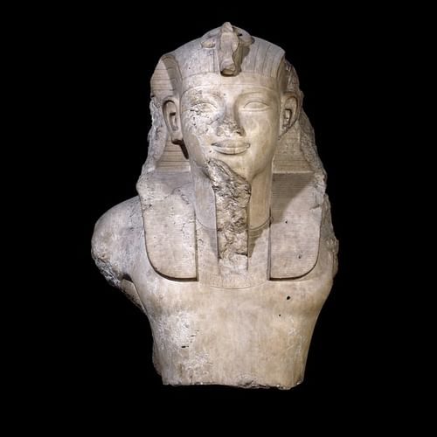
Amenhotep III (c.1386 – 1353 BCE)
ninth king of the 18th Dynasty
He was the son of the pharaoh Tuthmosis IV and his lesser wife Mutemwiya, husband of Queen Tiye, father of Akhenaten, and grandfather of Tutankhamun and Ankhsenamun.
greatest contribution to Egyptian culture
maintaining peace and prosperity
enabled him to devote his time to the arts
many of the most impressive structures of ancient Egypt were built under his reign
through military campaigns he strengthened the borders of his land & expanded them
ruled Egypt with Tiye for 38 years until his death
succeeded by Amenhotep IV, later known as Akhenaten.

Slide 7

ACTIVITY – Historical Context
Create a class mindmap/study notes about the historical context of the transition to power to Amenhotep IV/Akhenaten

Slide 8
Religious Practices
Political and economic stability
Historical Context
Cultural and artistic achievements
Social Structure

Slide 9
TEACHER ONLY – Historical Context
Political and Economic Stability
Powerful Dynasty: Akhenaten's father, Amenhotep III, ruled during a time of unprecedented prosperity and power for Egypt. The 18th Dynasty, to which they both belonged, was known for strong pharaohs who expanded Egypt's influence and wealth.
Trade and Wealth: Egypt engaged in extensive trade with neighboring regions, including Nubia, the Near East, and the Mediterranean. This trade brought wealth, luxury goods, and exotic materials into Egypt, contributing to the kingdom's prosperity.
Military Prowess: The pharaohs before Akhenaten maintained a strong military presence, securing Egypt's borders and exerting influence over vassal states in Canaan and Syria. Campaigns led by pharaohs such as Thutmose III expanded Egypt's empire and control over vital trade routes.

Slide 10
TEACHER ONLY – Historical Context
Religious Practices
Polytheism: Traditional Egyptian religion was polytheistic, with a pantheon of gods and goddesses. Amun-Ra, the king of the gods, was the most prominent deity, and his cult had a significant influence over both religious and political affairs.
Temple Cults: Temples dedicated to various gods were centers of economic and social life. The priesthood, particularly the priests of Amun, wielded substantial power and controlled vast wealth and resources.
Rituals and Festivals: Religious rituals, festivals, and ceremonies were integral to daily life and governance. Pharaohs were seen as divine intermediaries who performed rituals to ensure the favor of the gods and the continued prosperity of the land.

Slide 11
TEACHER ONLY – Historical Context
Cultural and Artistic Achievements
Architectural Marvels: The period before Akhenaten saw the construction of monumental architecture, including grand temples, elaborate tombs in the Valley of the Kings, and impressive statues and obelisks. Amenhotep III's reign was particularly noted for its architectural achievements, such as the Luxor Temple and his mortuary temple in Thebes.
Artistic Flourishing: Egyptian art maintained a consistent and formal style that emphasized order, balance, and idealized representations of gods, pharaohs, and daily life. Art and architecture served both religious and political purposes, reinforcing the divine nature of the pharaoh and the stability of the state.

Slide 12
TEACHER ONLY – Historical Context
Social Structure
Hierarchical Society: Egyptian society was highly stratified, with the pharaoh at the top, followed by a class of nobles, priests, scribes, artisans, and peasants. The pharaoh was considered a god-king who maintained Ma'at, the divine order.
Agricultural Economy: Egypt's economy was primarily based on agriculture, with the Nile River providing fertile land for crops. The predictable flooding of the Nile ensured consistent agricultural productivity, which supported the population and funded large state projects.
Education and Literacy: Literacy was relatively rare and primarily limited to scribes and officials who managed the administration, recorded transactions, and composed religious texts. Education for scribes was rigorous and prestigious.

Slide 13
Transition to power
Amenhotep III suffered from severe dental problems, arthritis, and possibly obesity in his final years.
He wrote to Tushratta, the king of Mitanni (one of whose daughters, Tadukhepa, was among Amenhotep III's lesser wives) to send him the statue of Ishtar that had visited Egypt before, at his wedding to Tadukhepa, to heal him.
Whether the statue was sent is a matter of controversy in the modern day and what, precisely, was ailing Amenhotep III is likewise. It has been suggested that his dental problems resulted in an abscess which killed him, but this has been disputed.
He died in 1353 BCE, and letters from foreign rulers, such as Tushratta, express their grief on his passing and their condolences to Queen Tiye.
These letters also make clear that these monarchs hoped to continue the same good relations with Egypt under the new king as they had with Amenhotep III. With Amenhotep III's passing, his son, then called Amenhotep IV, began his reign.

Slide 14
Watch the following
https://www.youtube.com/watch?v=C3IDB_KimCQ&ab_channel=OverlySarcasticProductions

Slide 15
SUMMARY
Describe in 2 – 3 sentences, the conditions in Egypt that led to Amenhotep IV gaining power

